Slide 1
Introduction to Algebraic Multigrid Solver: Part 11

Slide 2
Parallel Computing

Slide 3

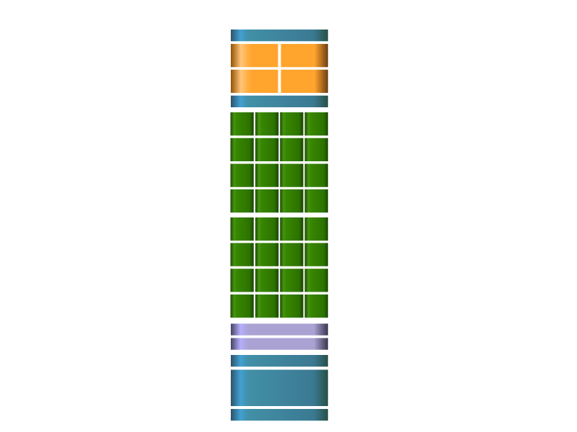

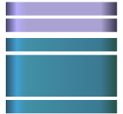

GPU Architecture
DRAM I/F
DRAM I/F
HOST I/F
DRAM I/F
L2
Giga Thread
DRAM I/F
DRAM I/F
DRAM I/F
GPU
SM

Slide 4
GPU Architecture

Slide 5
GPU Architecture

Slide 6
GPU Algorithm Design Issues
Processor hierarchy: SP, SM, (Half) Warp
Memory hierarchy: register, L1/L2 cache, shared memory, constant memory, global memory (and CPU memory)
Communication hierarchy: thread, block, CPU and GPU
Task division: thread, warp, block, grid
Memory access pattern: shared memory, global memory

Slide 7
Sparse Matrix-Vector Multiplication
Krylov subspace solvers and AMG solvers share common operations.
Linear vector operations, e.g.,
y = a * x + b * y, z = a * x + b * y, y = a * x
Dot product, d = <x, y>
Sparse matrix-vector operations, e.g.,
y = A * x, y = a * A * x + b * y, z = a * A * x + b * y

Slide 8
SPMV kernel
Matrix format: HEC (Hybrid of ELL format and CSR format)
J
V
i
i+1
Ap
J
i
V
ELL format
CSR format
ELL is in column-major order
One thread calculates on row of SPMV
Performance is better than HYB.
Scalar CSR, vector CSR, COO

Slide 9
Numerical Experiments
CPU, Intel Xeon X5570, 8M cache, 2.93GHz, 32G memory
GPU, NVIDIA Tesla C2050/C2075, 3G/6G memory
Environment: Linux (CentOS 6.3 x86_64), CUDA Toolkit 5.1, GCC 4.4.5
Compilation options: -arch=sm_20 –O3

Slide 10
SPMV
Matrix | CSR(V) | ELL | HYB | HEC
Human_gene1 | 4.85 | 0.84 | 2.68 | 1.13
msc23052 | 3.63 | 1.55 | 2.29 | 2.50
TSOPF_FS_b300_c2 | 8.62 | 5.42 | 5.41 | 8.96
cfd2 | 2.26 | 8.06 | 6.86 | 11.61
ESOC | 2.62 | 11.56 | 11.56 | 11.61
cage13 | 2.36 | 7.56 | 9.42 | 11.04
Af_shell8 | 3.58 | 8.66 | 9.63 | 11.12
Parabolic_fem | 1.12 | 9.97 | 7.56 | 10.00
Emilia_923 | 3.69 | 6.64 | 8.36 | 8.65
atmosmodd | 1.38 | 14.54 | 14.50 | 14.57
Serena | 3.58 | 1.79 | 7.26 | 7.29
Hook_1498 | 3.48 | 5.39 | 7.89 | 8.01
SPE10 | 1.74 | 1.24 | 11.15 | 10.27

Slide 11
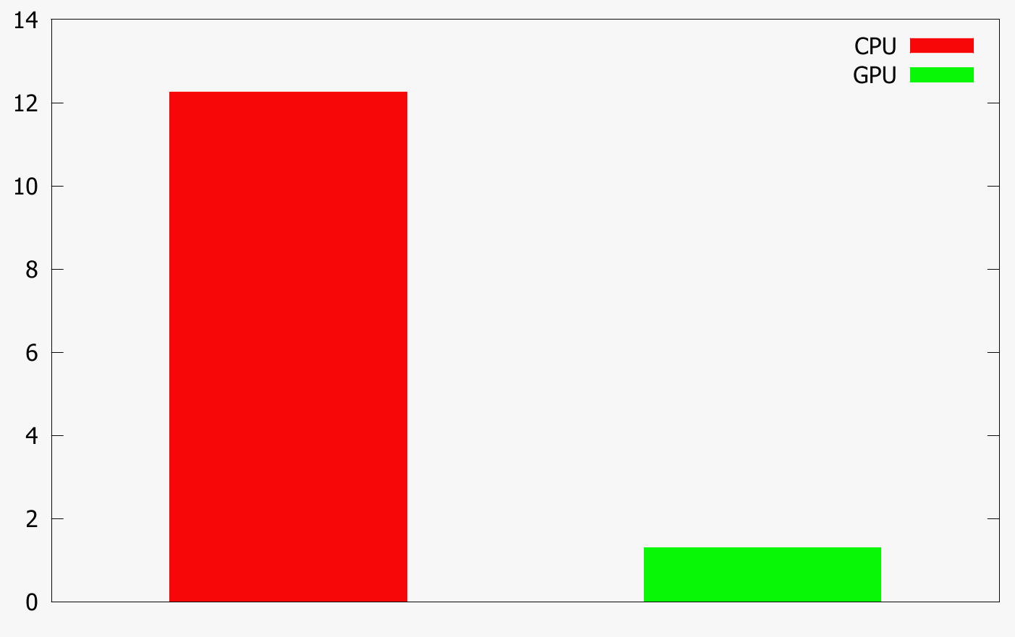
AMG: Example 1
Grid size: 1,000x1,000
Tol: 1e-6, level: 8
36 iterations
GPU: 1.30s
CPU: 12.26s
Speedup: 9.33

Slide 12
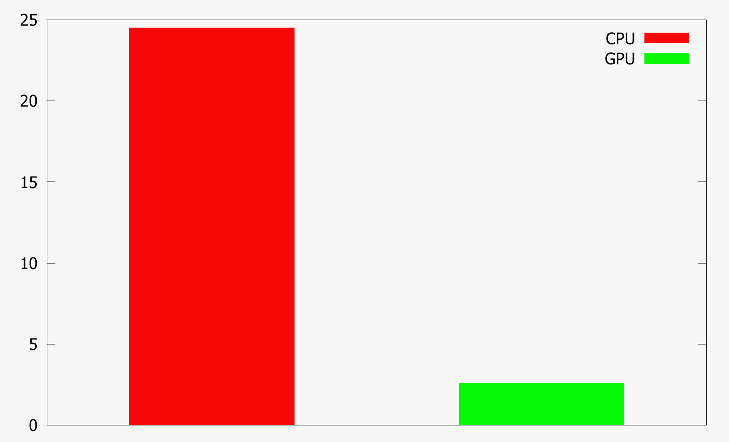
AMG: Example 2
Grid size: 1,500x1,500
Tol: 1e-6, level: 8
31 iterations
GPU: 2.58s
CPU: 24.50s
Speedup: 9.42

Slide 13
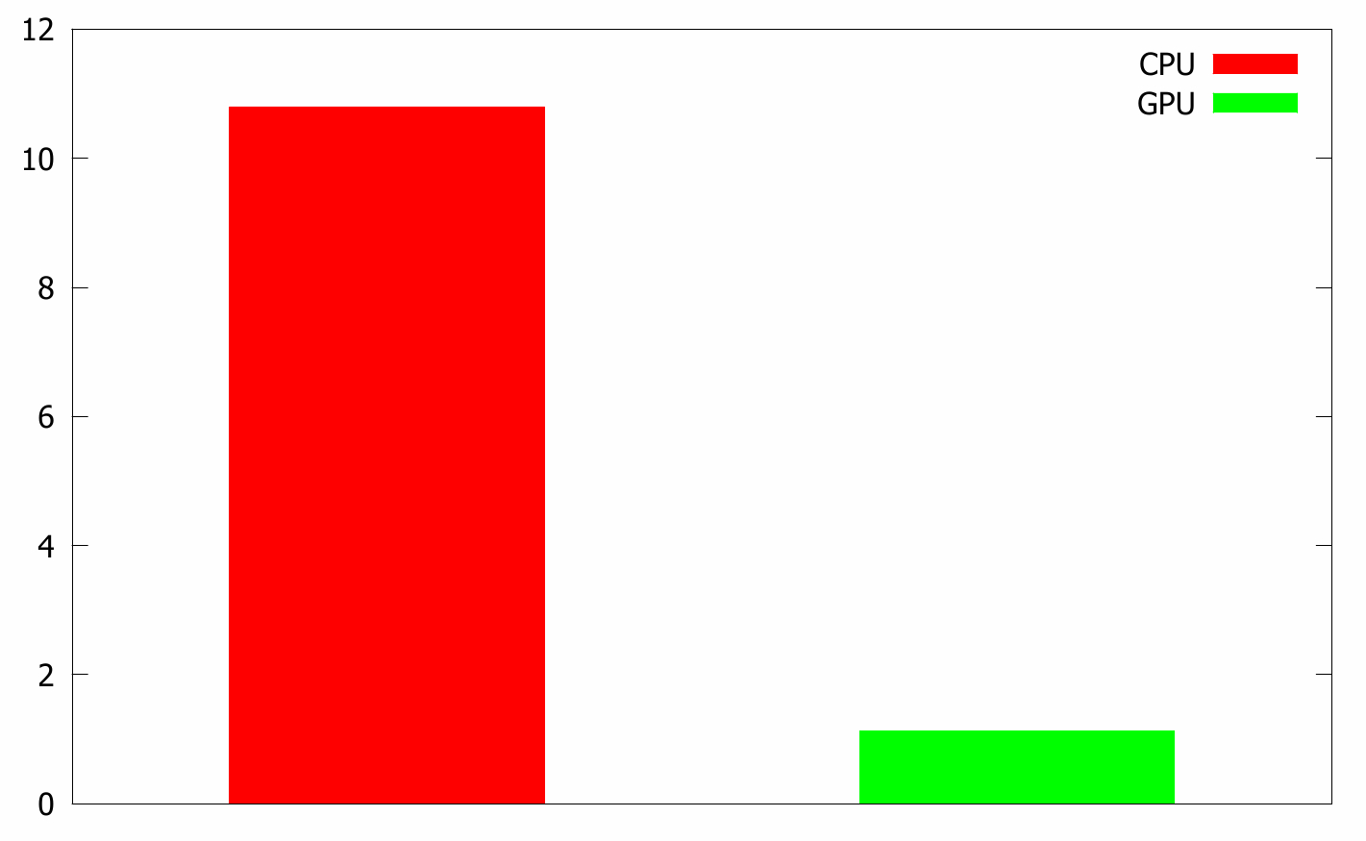
AMG: Example 3
Grid size: 100x100x100
Tol: 1e-6, level: 8
21 iterations
GPU: 1.13s
CPU: 10.80s
Speedup: 9.58

Slide 14
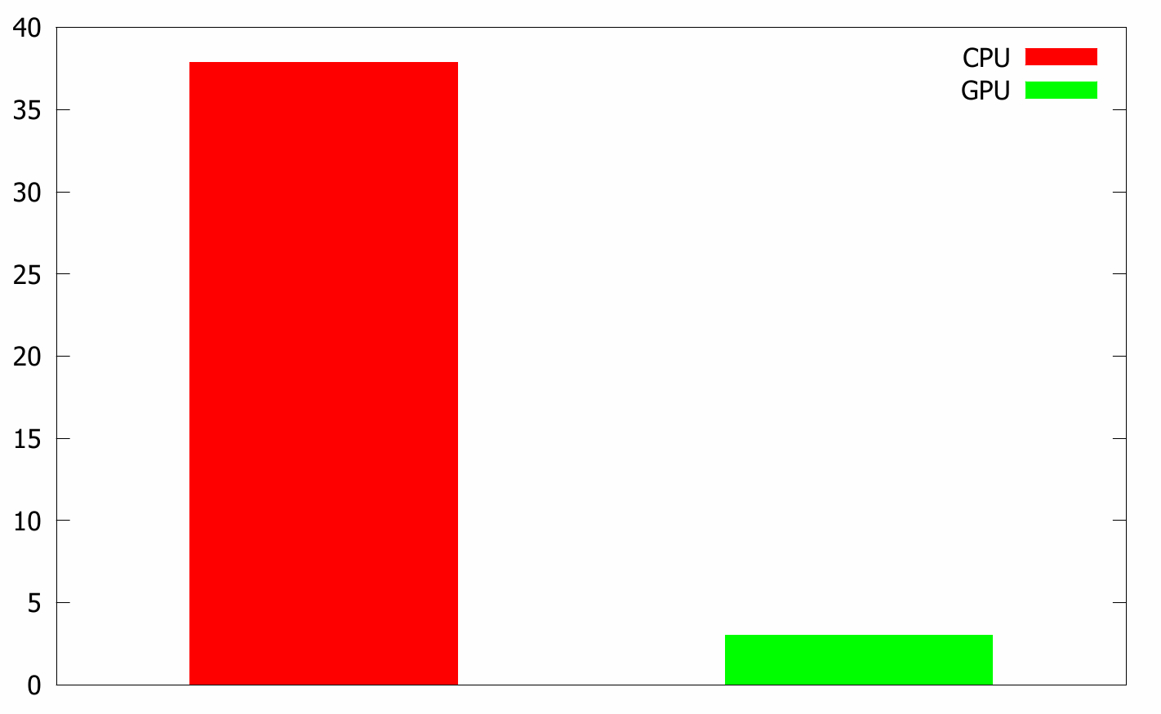
AMG: Example 4
Grid size: 130x130x130
Tol: 1e-6, level: 8
25 iterations
GPU: 3.02s
CPU: 37.86s
Speedup: 12.47

Slide 15

THANK YOU
PPT模板下载：www.1ppt.com/moban/ 行业PPT模板：www.1ppt.com/hangye/
节日PPT模板：www.1ppt.com/jieri/ PPT素材下载：www.1ppt.com/sucai/
PPT背景图片：www.1ppt.com/beijing/ PPT图表下载：www.1ppt.com/tubiao/
优秀PPT下载：www.1ppt.com/xiazai/ PPT教程： www.1ppt.com/powerpoint/
Word教程： www.1ppt.com/word/ Excel教程：www.1ppt.com/excel/
资料下载：www.1ppt.com/ziliao/ PPT课件下载：www.1ppt.com/kejian/
范文下载：www.1ppt.com/fanwen/ 试卷下载：www.1ppt.com/shiti/
教案下载：www.1ppt.com/jiaoan/
字体下载：www.1ppt.com/ziti/

